Slide 1
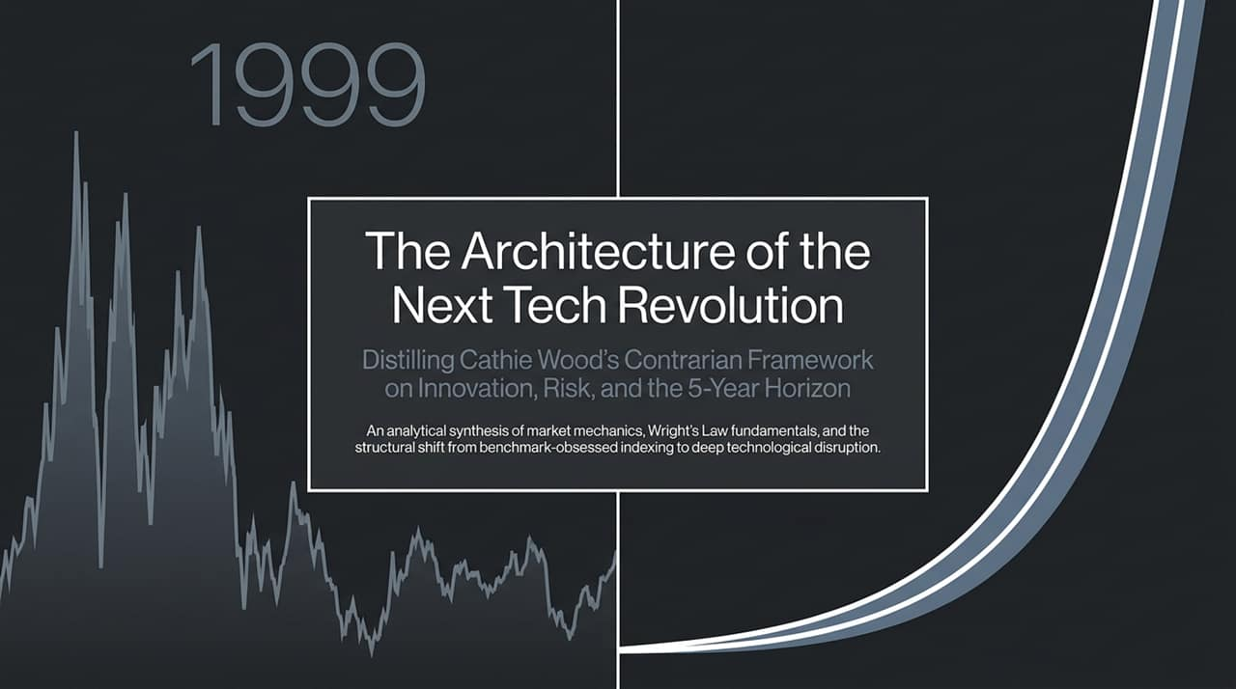
Notes:
Introduction & Context:
Good morning, everyone. Today we are exploring 'The Architecture of the Next Tech Revolution', a contrarian investment framework synthesized directly from Cathie Wood and ARK Invest.
In today's market environment, institutional investing has increasingly drifted toward passive, benchmark-sensitive indexing. What we are presenting today is a fundamental departure from benchmark tracking. It is an analytical look at how technological platforms follow predictable cost curves and converge to create multi-trillion-dollar opportunities over a 5-year time horizon.
Framework Overview:
Throughout this deck, we will examine why the current market backdrop is not a repeat of the 1999 tech bubble, how Wright's Law acts as the primary cost-forecasting engine, and why active research in pure-play innovation is crucial at a time when standard benchmarks miss private-market growth and early-stage technological adoption.
Let’s start by looking at what ARK stands for and why active research in technology was born out of a major post-2008 structural gap.
https://www.youtube.com/watch?v=1RBpOq62vwQ

Slide 2
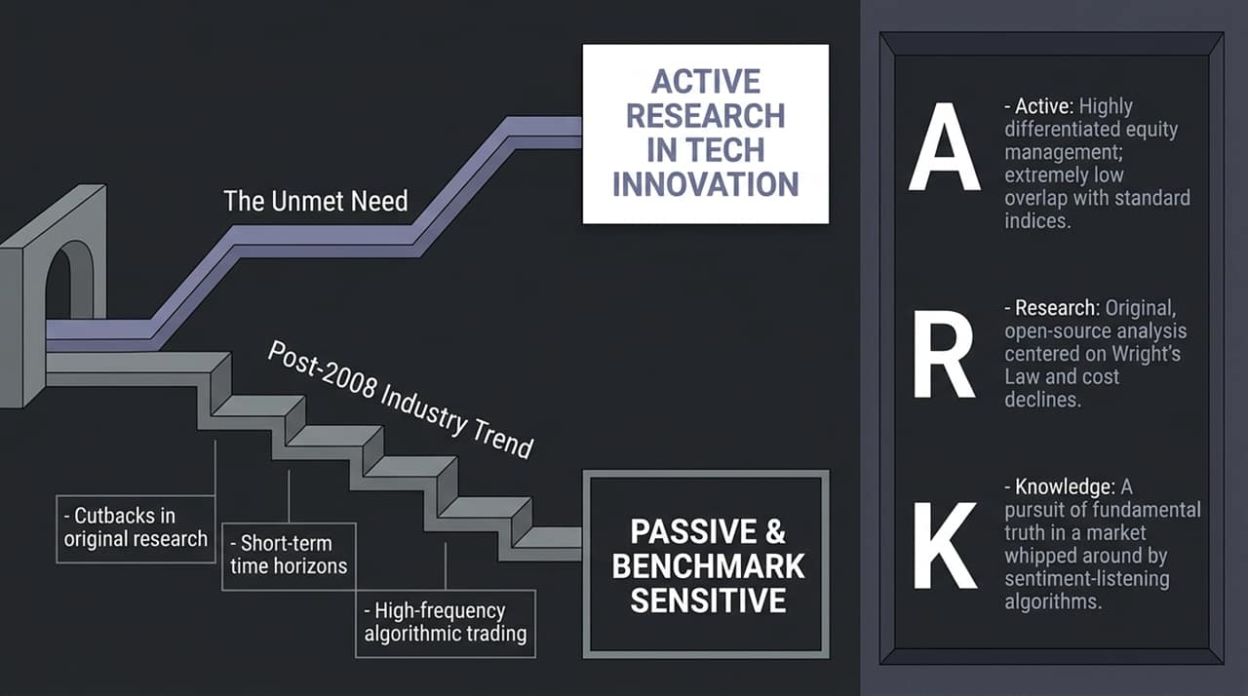
Notes:
The Structural Gap (Post-2008 Industry Trend):
"To understand ARK’s mission, we must look back at the aftermath of the 2008–2009 Global Financial Crisis. Following 2008, the asset management industry underwent a structural shift: banks and institutional asset managers severely cut back on deep, original research into tech innovation. Innovation came to be viewed as 'risk' because it strayed too far from standard benchmark weights."
"As a result, capital systematically migrated into passive, benchmark-sensitive strategies. Time horizons shrank dramatically from multi-year fundamental outlooks to quarterly earnings reactions, dominated by high-frequency algorithmic trading."
The Unmet Need & The ARK Acronym:
"Cathie Wood recognized this exact gap as an unmet market need. ARK stands for:
Active: Highly differentiated equity management with extremely low overlap with standard indices.
Research: Original, open-source analysis centered around cost declines governed by Wright’s Law rather than traditional financial modeling.
Knowledge: A relentless pursuit of fundamental truth in a market increasingly driven by short-term sentiment algorithms."
Open-Source Research Methodology:
"Crucially, ARK adopted an open-source model—publishing research transparently on social media to engage directly with scientists, engineers, and industry pioneers in real time."

Slide 3
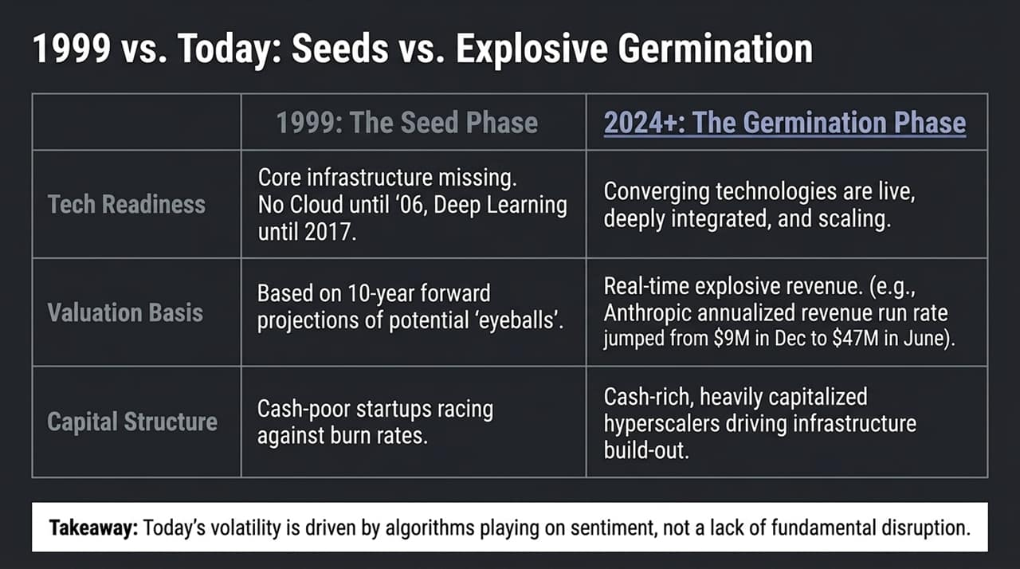
Notes:
Deconstructing the '1999 Analogy':
"A common narrative among skeptical investors today is that current AI valuations and capital expenditures mirror the 1999 Dot-Com bubble. However, analyzing the core fundamentals reveals three distinct structural differences:"
1. Technological Readiness (Seeds vs. Germination):
"In 1999, the ideas were visionary, but the underlying infrastructure did not exist. There was no Cloud infrastructure until 2006, and Deep Learning breakthrough architectures didn't emerge until 2017. 1999 was the seed phase. Today, we are in the germination/explosion phase—the foundational technologies are live, integrated, and rapidly scaling."
2. Valuation Basis:
"In 1999, valuations were based on 10-year forward projections of potential 'eyeballs' without underlying cash flows. Today, platforms are producing real-time revenue surges. For instance, Anthropic's annualized revenue run rate jumped from $9M in December to $47M by June due to rapid enterprise adoption of models like Claude."
3. Capital Structure & Cash Reserves:
"1999 was characterized by cash-poor, burn-rate-heavy startups. Today’s massive AI infrastructure buildout is powered by heavily capitalized, cash-rich hyperscalers with immense balance sheets."
Takeaway:
"Today’s market price swings are driven by high-frequency algorithms reacting to sentiment noise, not by a lack of real fundamental adoption."

Slide 4
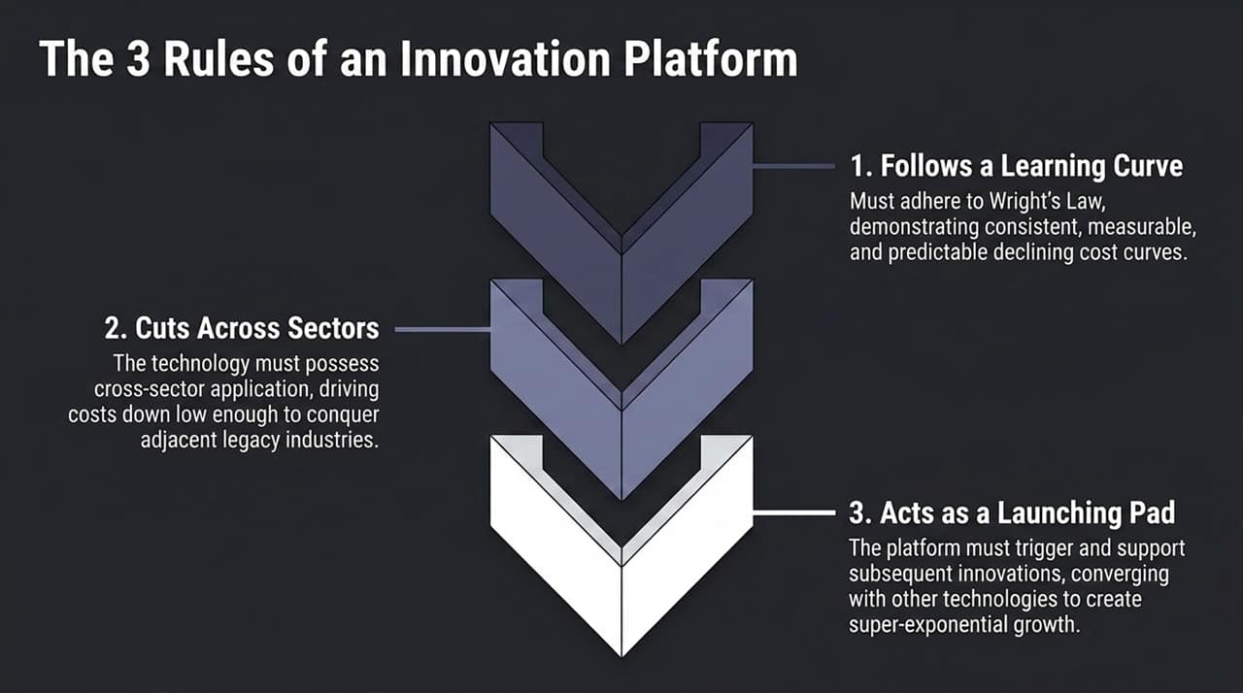
Notes:
Defining True Innovation:
"Not every new product or exciting gadget constitutes a macro-level technological platform. At ARK, for a technology to qualify as an Innovation Platform, it must satisfy three rigorous conditions:"
Rule 1: Follows a Learning Curve (Wright’s Law):
"The technology must exhibit consistent, predictable, and unit-based cost declines. As production volume scales, production costs must decline at a fixed percentage rate."
Rule 2: Cuts Across Sectors:
"A true platform cannot remain siloed within a single industry. Its unit economics must fall low enough to cross over and disrupt adjacent legacy sectors. For example, battery technology started in consumer electronics, crossed into automotive transport, and is now disrupting utility power grids."
Rule 3: Acts as a Launching Pad:
"The platform must spawn subsequent innovations and converge with other platforms. When multiple learning curves merge, they unlock super-exponential growth curves."

Slide 5
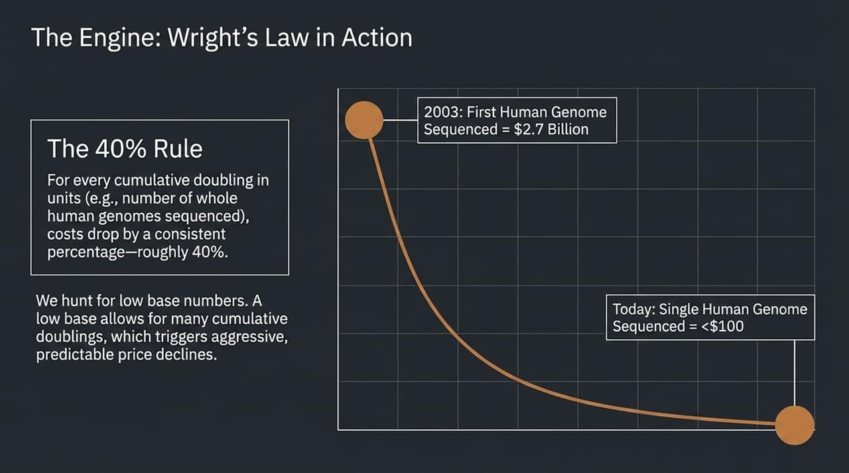
Notes:
Wright’s Law vs. Moore’s Law:
"While Wall Street relies heavily on time-based projections like Moore's Law, ARK relies on Wright's Law—a cost function modeled on cumulative unit production."
The 40% Rule in Genomics:
"Wright’s Law states that for every cumulative doubling of units produced, cost drops by a fixed percentage. In whole-genome DNA sequencing, this cost decline rate is approximately 40% per cumulative doubling."
Real-World Case Study:
"In 2003, sequencing the first human genome required 13 years and $2.7 billion. Today, sequencing a full human genome costs under $100."
Strategic Implication — Hunting for Low Base Numbers:
"Why does this matter to investors? We actively seek technologies starting from a low base of production. A low starting base allows for frequent, consecutive doublings, triggering rapid and predictable price collapses that open up mass commercial markets."

Slide 6
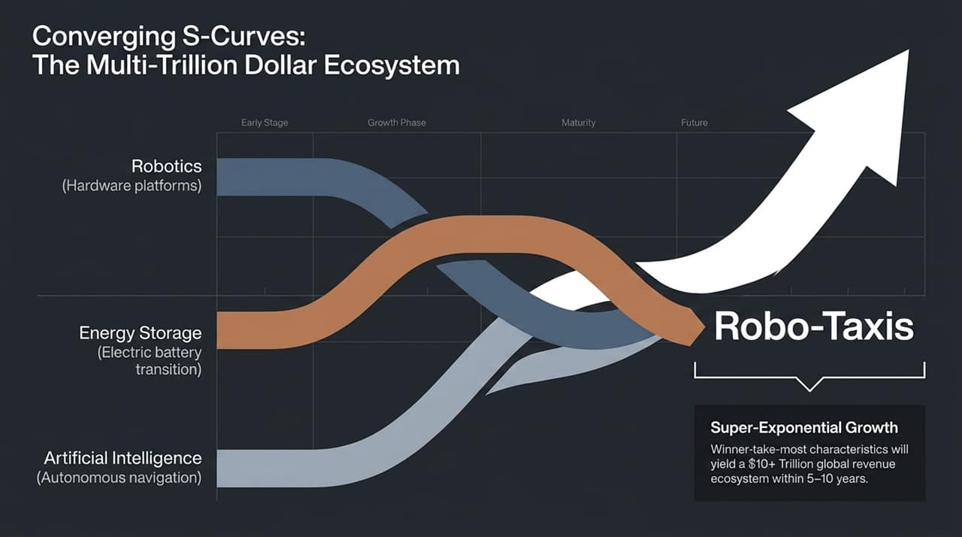
Notes:
Understanding Technological Convergence:
"When individual innovation platforms mature simultaneously, they converge to create entirely new markets. We call this the convergence of S-Curves."
The Autonomous Vehicle / Robo-Taxi Example:
"Consider autonomous mobility. It is not a single technology; it is the physical intersection of three distinct platforms:
Robotics: The physical, drive-by-wire hardware vehicle platform.
Energy Storage: Advanced battery chemistry enabling high-utilization electric drivetrains.
Artificial Intelligence: Real-time neural networks driving autonomous navigation."
Ecosystem Scale & Winner-Take-Most Dynamics:
"Because this convergence creates superior utility at a fraction of human-driven transport costs, it exhibits strong 'winner-take-most' characteristics. The first providers to reach threshold safety and scale will capture the majority of market share."
"We project this converged global robo-taxi ecosystem will unlock over $10 trillion in global revenue over the next 5 to 10 years."

Slide 7
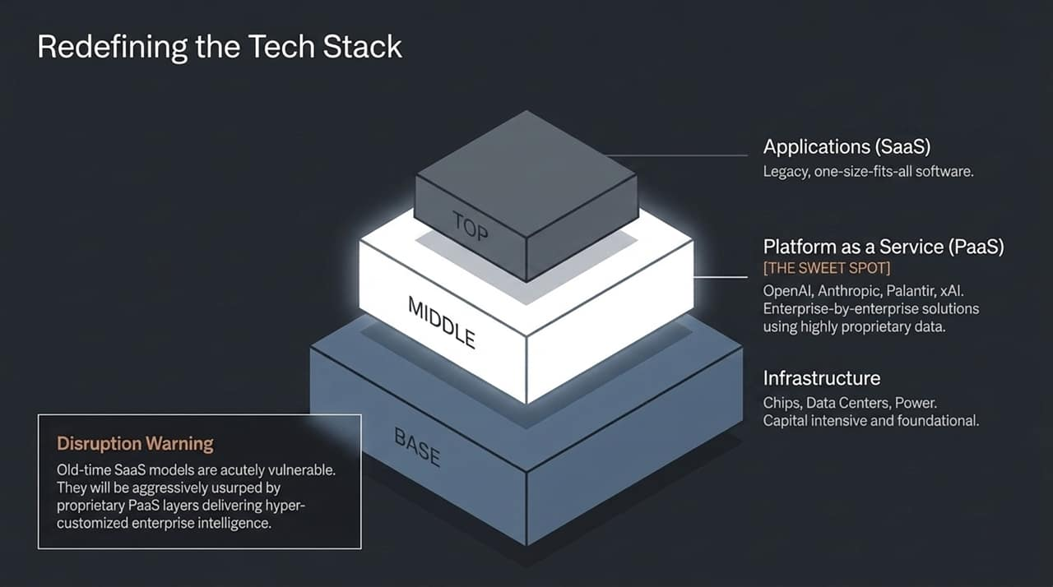
Notes:
Structural Shift in the Technology Stack:
"The AI revolution is completely restructuring the traditional enterprise tech stack. We break the stack into three core layers:"
1. Base Layer: Infrastructure
"Chips, data centers, compute capacity, and power infrastructure. Extremely capital-intensive, high capex, foundational buildout."
2. Middle Layer: Platform as a Service (PaaS) — The Sweet Spot
"This layer includes companies like OpenAI, Anthropic, Palantir, and xAI. PaaS offers custom, enterprise-by-enterprise intelligence layers built on top of highly proprietary enterprise data."
3. Top Layer: Applications (Legacy SaaS)
"Traditional application software (one-size-fits-all SaaS)."
Disruption Warning on Legacy SaaS:
"Old-school SaaS models that charge seats for standard interfaces are deeply vulnerable. They are being rapidly usurped by custom PaaS layers that integrate directly into corporate workflows using custom data, rendering generic software seats obsolete."

Slide 8
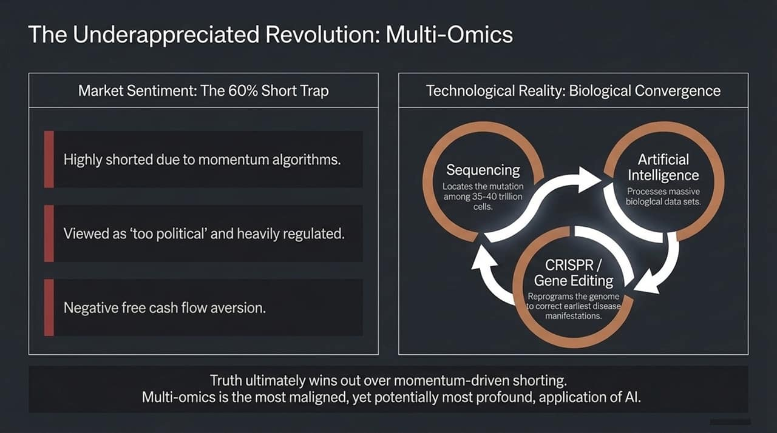
Notes:
Market Sentiment vs. Fundamental Reality:
"Multi-omics and genomic healthcare represent perhaps the most maligned yet profound application of AI today."
The 60% Short Trap:
"Due to momentum-based algorithms, high short interest accumulated across the multi-omics space (reaching up to 60% in specialized ETFs like ARKG). The consensus narrative labeled healthcare innovation as 'too political', heavily bureaucratic, and constrained by negative near-term free cash flow."
Technological Reality (Biological Convergence):
"However, behind this sentiment wall, a massive technological triad has converged:
Sequencing: Pinpointing individual mutations among 35–40 trillion human cells.
Artificial Intelligence: Analyzing massive, multi-tiered biological datasets.
CRISPR / Gene Editing: Reprogramming human DNA to correct disease at its foundational source."
Summary:
"Short-term momentum algorithms can suppress stock prices, but biological truth and curative outcomes eventually overwhelm algorithmically driven short positions."

Slide 9
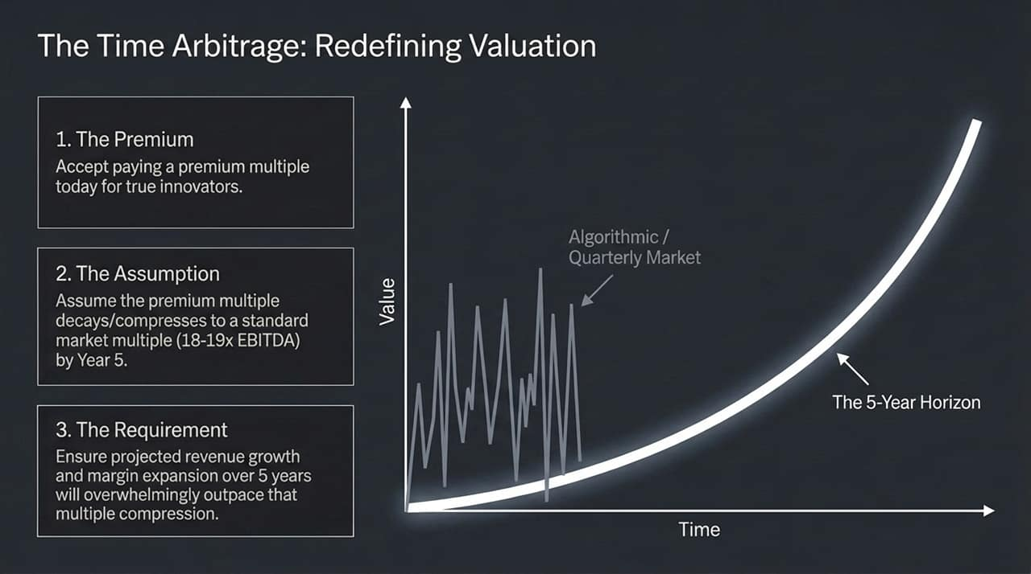
Notes:
The 5-Year Horizon vs. Quarterly Noise:
"Wall Street is obsessed with quarterly earnings results and short-term multiples. We operate on a 5-year time horizon, leveraging what we call 'Time Arbitrage'."
The 3-Step Valuation Framework:
Accepting a Premium Multiple: "We willingly pay a premium valuation multiple today for true, hyper-growth innovators."
Assuming Multiple Compression: "In our base financial models, we explicitly assume that this elevated premium multiple will compress dramatically over 5 years down to a standard market multiple (18x–19x EBITDA)."
Growth Outpacing Compression: "For an asset to enter the portfolio, our projected 5-year revenue growth and margin expansion must overwhelmingly outpace that multiple compression."
Key takeaway:
"By forcing an 18–19x terminal EBITDA assumption into our 5-year models, we maintain strict valuation discipline while remaining anchored to structural long-term growth."

Slide 10
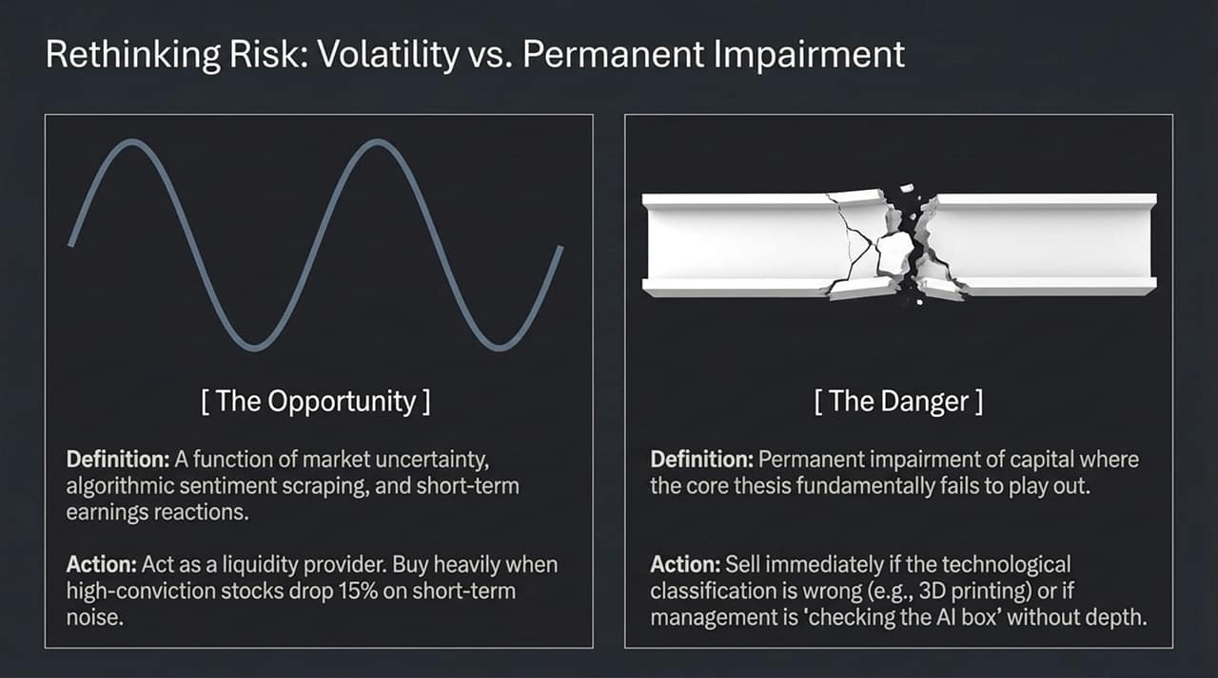
Notes:
Reframing Volatility:
"Standard financial theory equates risk with volatility (standard deviation). We view them as fundamentally distinct concepts."
Volatility as an Opportunity:
"Volatility is driven by macroeconomic uncertainty, sentiment-scraping algorithms, and short-term earnings noise. When high-conviction positions drop 15% due to short-term sentiment without altering the core thesis, we act as liquidity providers—buying low and taking advantage of algorithm-driven overreactions."
The Real Danger: Permanent Capital Impairment:
"Real risk is the permanent impairment of capital—where the fundamental underlying thesis fails."
When to Sell:
"We exit positions immediately if:
The core technology classification was incorrect (as was the case when 3D printing proved to be an automated tool rather than a standalone macroeconomic platform).
Management is merely 'checking the AI box' without deep talent or genuine enterprise implementation."

Slide 11
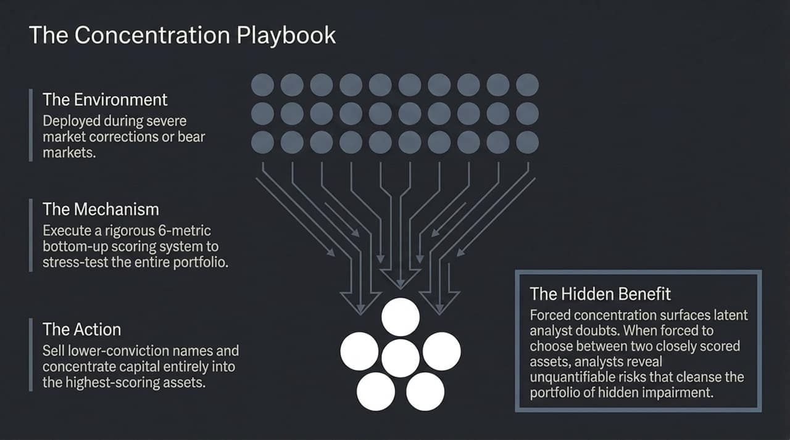
Notes:
Managing Capital in Market Corrections:
"During severe market pullbacks or tech downturns, we execute a disciplined capital management tactic: The Concentration Playbook."
The 6-Metric Bottom-Up Scoring System:
"We evaluate every holding in our universe against a rigorous 6-metric bottom-up scoring system."
"Instead of spreading capital across the entire spectrum, we sell off lower-scoring, lower-conviction holdings and concentrate capital directly into our highest-scoring assets."
The Hidden Analytical Benefit:
"Forced concentration forces analysts to make tough trade-offs. When forced to choose between two similarly scored assets, analysts surface subtle, unquantifiable risks—such as management hesitation or talent depth—that might otherwise go unmentioned."
"This process cleanses the portfolio of subtle structural risks before they turn into permanent capital losses."

Slide 12
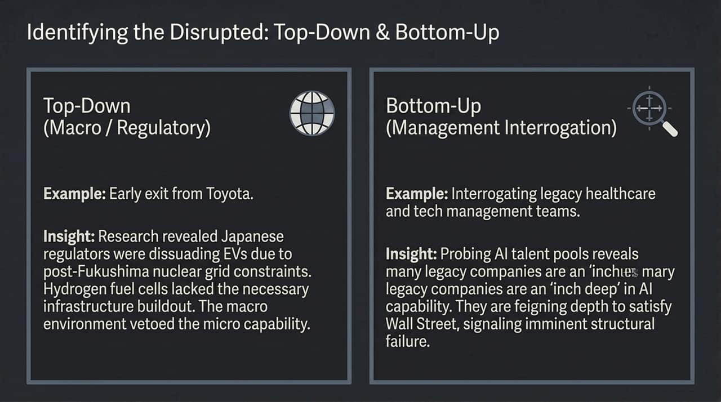
Notes:
Top-Down Macro/Regulatory Assessment (The Toyota Case Study):
"Top-down research evaluates macroeconomic and regulatory friction. Early in ARK’s history, we exited our position in Toyota. Why? Our top-down research revealed that Japanese regulators were discouraging EV adoption due to electrical grid constraints following the Fukushima nuclear shutdown."
"Toyota shifted focus to hydrogen fuel cell development, but our research showed that the required fueling infrastructure buildout was financially unviable. Macro regulatory constraints effectively vetoed micro manufacturing potential."
Bottom-Up Management Interrogation:
"Bottom-up research requires interrogating corporate leadership and probing engineering talent pools."
"In assessing legacy tech and healthcare providers, deep interviews frequently reveal that companies boasting about AI adoption are only 'an inch deep' in genuine talent. They check the narrative box for quarterly calls, masking imminent structural disruption."

Slide 13
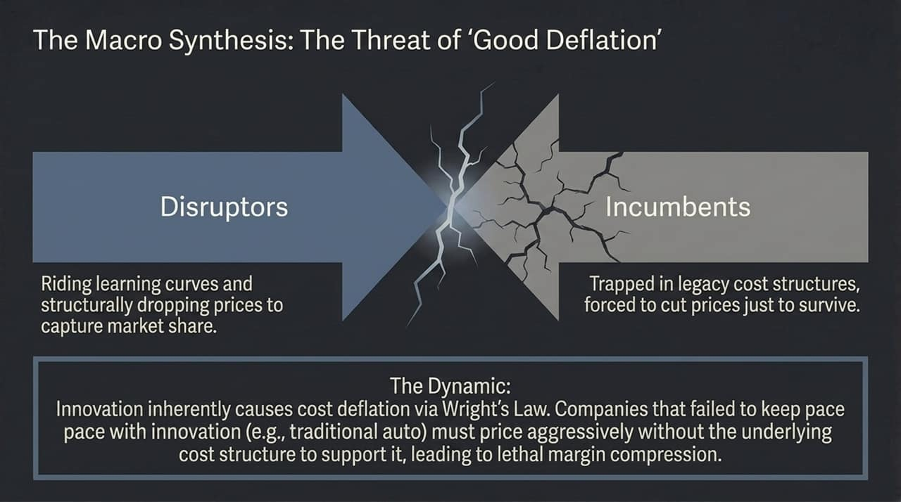
Notes:
Innovation Causes Cost Deflation:
"A critical macro insight of our research is that technological innovation is fundamentally deflationary. Wright’s Law dictates that cost structures naturally decline over time."
Two Sides of Deflation:
Disruptors ('Good Deflation'): "Disruptors ride cost curves down, passing savings along to consumers via lower prices while expanding their operating margins and capturing massive market share."
Incumbents ('Trapped Deflation'): "Legacy incumbents are burdened with heavy legacy infrastructure and high fixed costs. To retain market share against disruptors, they are forced to slash prices aggressively—without the underlying cost reductions required to sustain profits."
The Resulting Impact:
"This dynamic causes severe, lethal margin compression for incumbent auto, software, and healthcare providers who fail to innovate at pace."

Slide 14
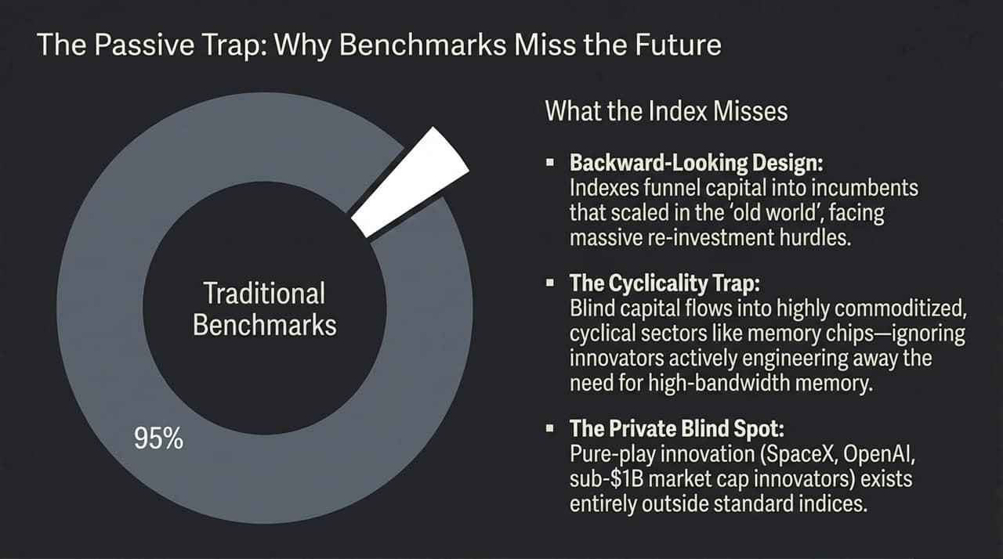
Notes:
The Risk of Passive Indexing:
"Over 95% of institutional capital flows are tied to traditional, market-cap-weighted benchmark indices. However, passive indexing presents three structural vulnerabilities:"
1. Backward-Looking Market Structure:
"Cap-weighted indices allocate the most capital to companies that scaled successfully in the previous economic cycle. These incumbents now face massive reinvestment hurdles and margin threats."
2. The Cyclicality Trap:
"Indexing blindly directs capital into heavily commoditized, highly cyclical supply chain segments—such as high-bandwidth memory chips—ignoring innovative architectures designed to engineer those costly components out of the supply chain entirely."
3. The Private & Sub-Billion Blind Spot:
"Pure-play disruptors (such as SpaceX, OpenAI, Anthropic, or early sub-$1B market cap innovators) exist entirely outside standard benchmark indices."

Slide 15
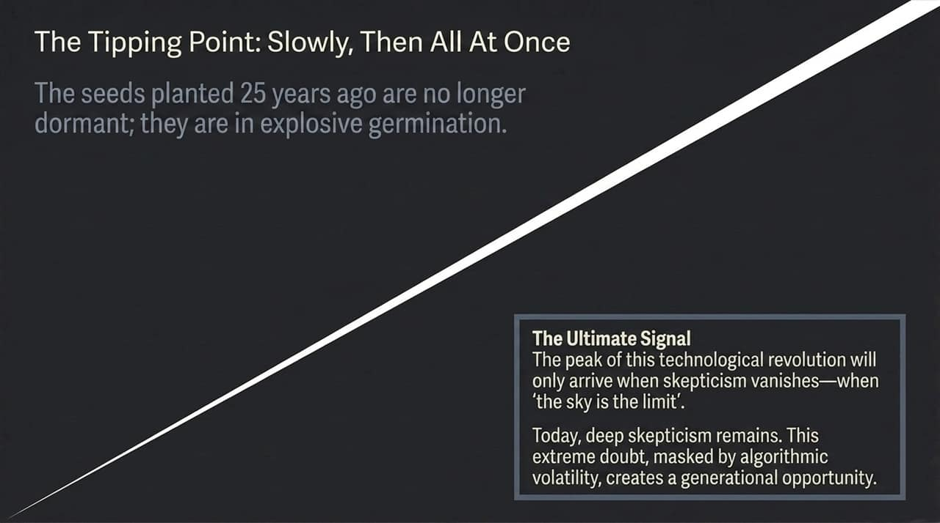
Notes:
Explosive Germination Phase:
"Technological transformation progresses gradually at first, then exponentially—'slowly, then all at once'. The technological seeds planted 25 years ago are now fully germinated."
Skepticism as a Safeguard:
"How do we know we are not currently in a market bubble? A true market peak occurs when skepticism completely evaporates—when market sentiment consensus is that 'the sky is the limit'."
Current Market Opportunity:
"Today, pervasive skepticism, high short interest, and widespread anxiety over tech expenditure remain prevalent across institutional markets. This skepticism, combined with short-term algorithmic volatility, creates a compelling generational entry point for long-term investors."

Slide 16
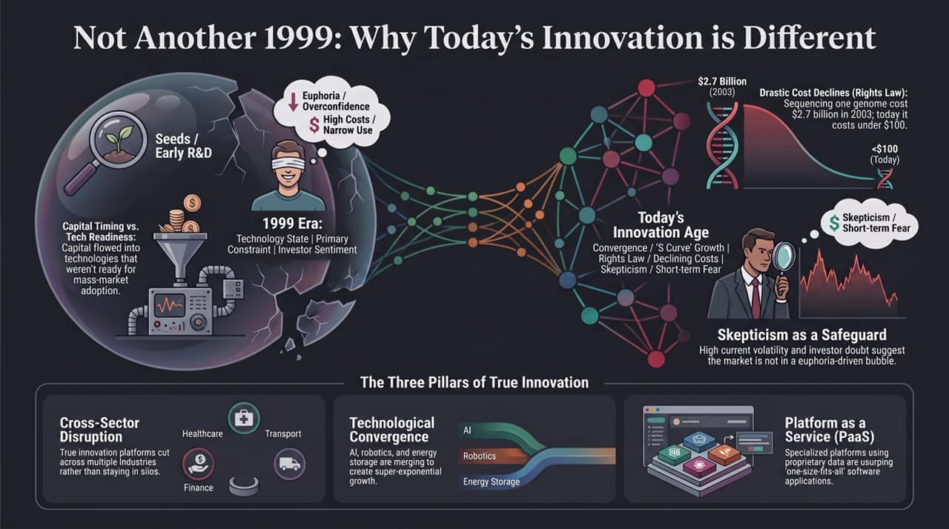
Notes:
Concluding Comparison (1999 vs. Today):
"To wrap up today’s presentation, let’s revisit the core thesis: This is not another 1999."
"In 1999, high costs, narrow use cases, immature infrastructure, and speculative valuations based on projected 'eyeballs' led to a market crash."
"Today, market dynamics are grounded in drastic Wright's Law cost declines (e.g., DNA sequencing dropping from $2.7 billion down to under $100) and real, rapidly scaling enterprise revenues."
The Three Core Pillars of True Innovation:
Technological Convergence: "AI, Robotics, and Energy Storage are merging to generate super-exponential economic growth."
Platform as a Service (PaaS): "Custom, enterprise-tailored platforms leveraging proprietary data are displacing legacy, one-size-fits-all SaaS applications."
Skepticism as a Safeguard: "Pervasive short-term fear and algorithmic market volatility ensure that high-conviction long-term investors can capture substantial time arbitrage."
Closing:
"Thank you for your time. I welcome any questions regarding our 5-year modeling assumptions or research methodology."

